Slide 1
Arduino Workshop
By Wei qianjun
Eee/4

Slide 2
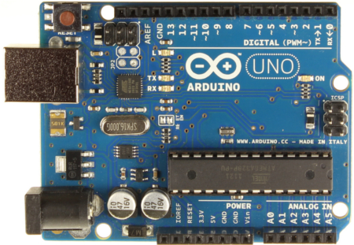
Basic introduction
Digital Output
Serial Port
Power
External Power
Analog Input

Slide 3
Setup Development Enviroment
Download the Arduino environment
http://arduino.cc/en/Main/Software
Connect the board
Install the drivers

Slide 4
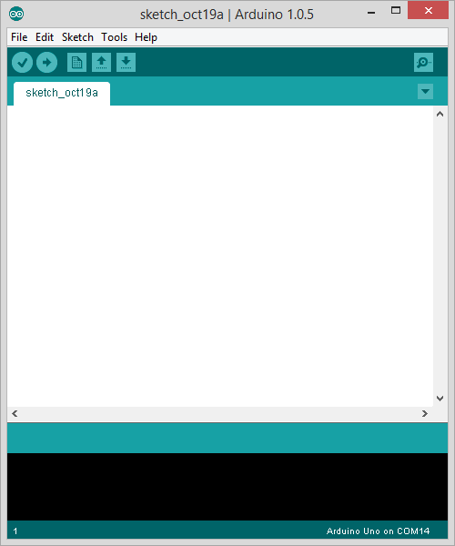
Start
Launch the Arduino application

Slide 5
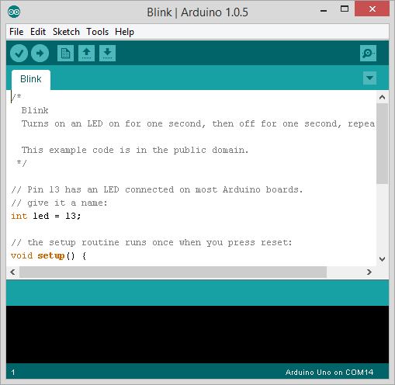
Start With An Example---Blink
File → Examples → Basics → Blink

Slide 6
Blink Code-By using delay()
// Pin 13 has an LED connected on most Arduino boards.
// give it a name:
int led = 13;
// the setup routine runs once when you press reset:
void setup() {
// initialize the digital pin as an output.
pinMode(led, OUTPUT); }
// the loop routine runs over and over again forever:
void loop() {
digitalWrite(led, HIGH); // turn the LED on (HIGH is the voltage level)
delay(1000); // wait for a second
digitalWrite(led, LOW); // turn the LED off by making the voltage LOW
delay(1000); // wait for a second}

Slide 7
millis()
Description
Returns the number of milliseconds since the Arduino board began running the current program. This number will overflow (go back to zero), after approximately 50 days.
Parameters
None
Returns
Number of milliseconds since the program started (unsigned long)

Slide 8
Blink Code-Without using delay()
const int ledPin = 13; // the number of the LED pin int ledState = LOW; // ledState used to set the LED long previousMillis = 0; // will store last time LED was updated long interval = 1000; // interval at which to blink (milliseconds) void setup() { pinMode(ledPin, OUTPUT); } void loop() { unsigned long currentMillis = millis(); if(currentMillis - previousMillis > interval) { previousMillis = currentMillis; // if the LED is off turn it on and vice-versa: if (ledState == LOW) ledState = HIGH; else ledState = LOW; // set the LED with the ledState of the variable: digitalWrite(ledPin, ledState); } }

Slide 9
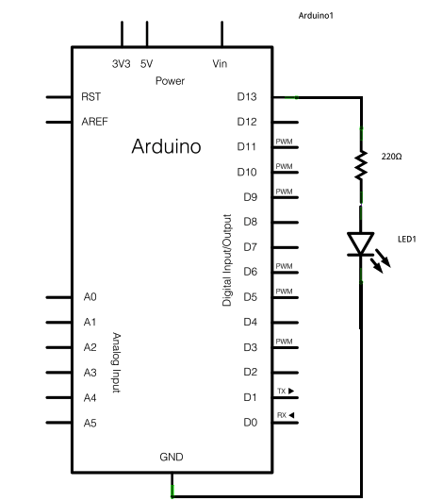
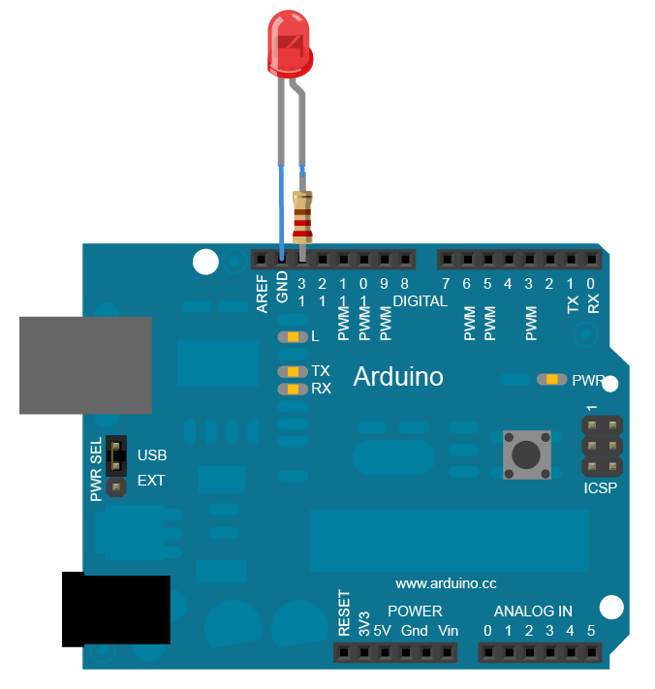
Blink Circuit

Slide 10
Exercise 1
Writer a program to make 8 leds on and off sequences
The delay is 0.2 second

Slide 11
THANK YOU !

